Slide 1
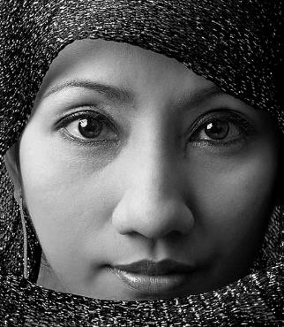
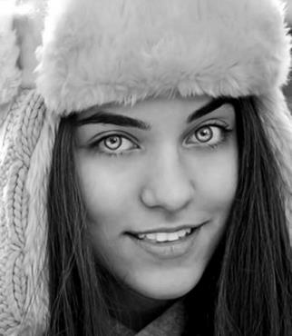
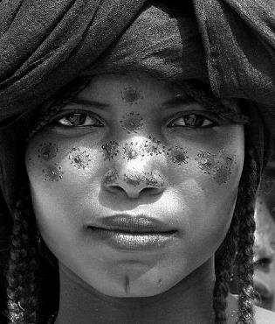
Fariza, Malaysia
Ella, Finland
Samira, Nigeria
GREECE
Notes:
1

Slide 2
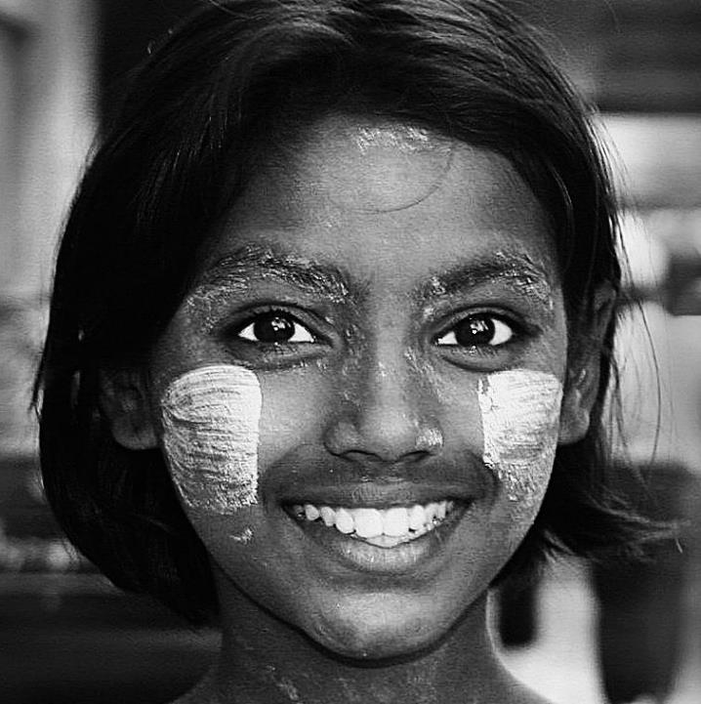
A boutique travel management company
with expertise in smart luxury

Slide 3
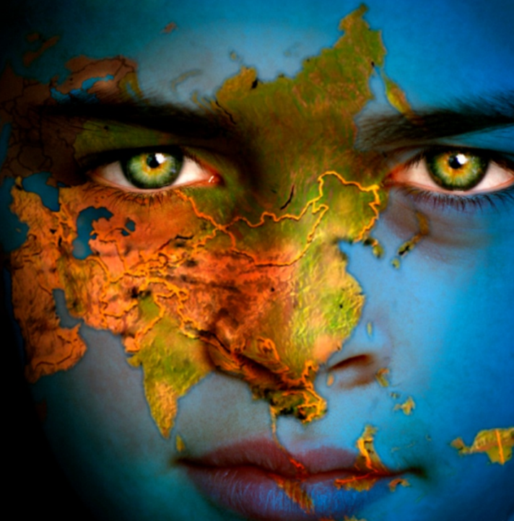
Explore.
Experience.
Enjoy.
Farscape was born from our passion for travelling to explore the world, coupled with our genuine desire for sharing extraordinary experiences with others.
Notes:
Mark Twain. American author. Wrote The Adventures of Tom Sawyer (1876). Died in 1910.

Slide 4
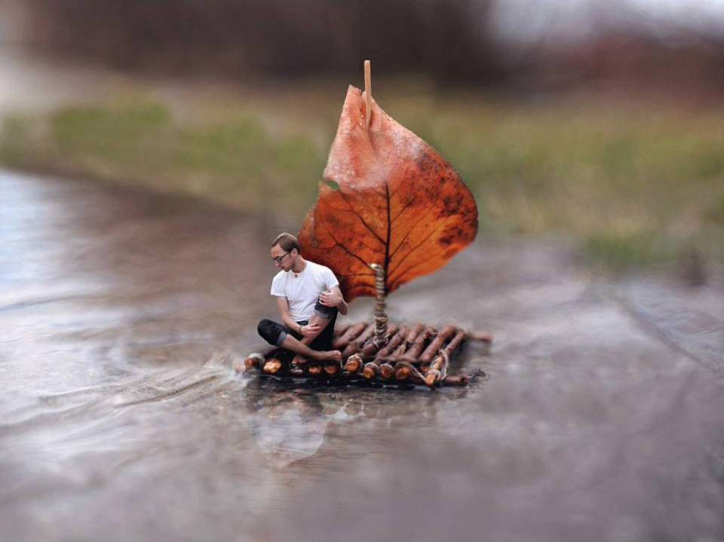
“We want to design trips that matter, concepts that delight and experiences people can’t stop talking about.”
- Savas KAZANTZIDES
OUR DNA
[ FEATURES ]
Joel Robison photography

Slide 5
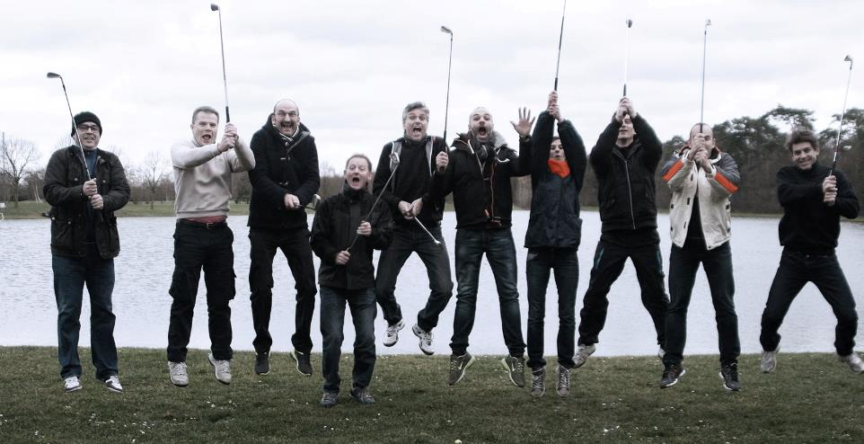
HERE IS HOW you benefit
Notes:
Our Advantages

Slide 6
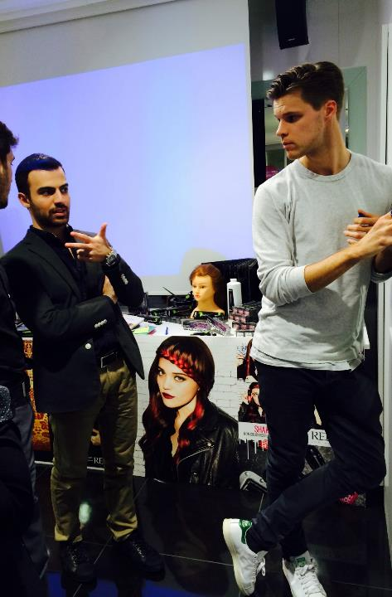
BETTER
PLANNING
Our unique personal-based approach helps us understand how to better address every one of your wants, needs, hopes, interests and even concerns.
We ask you the questions to extract your needs, understand your wants to tailor the result just for you and your guests.
Team Planning & Brainstorming

Slide 7
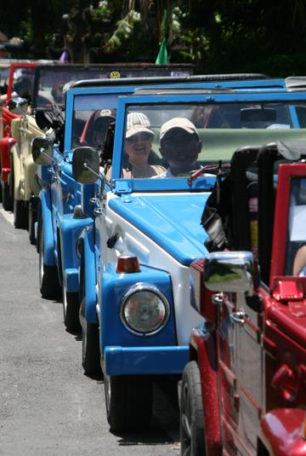
BETTER
VALUE
Our collective intelligence, extensive travelling, and constant updates on the world’s coolest places, the most talked-about spots, the insiders’ “must-see’s” and the locals’ “must-do’s” buys you time and costs you less effort to enjoy the absolute best that your budget can buy.
22 Cars , 22 drivers, 66 guests Fascinating

Slide 8
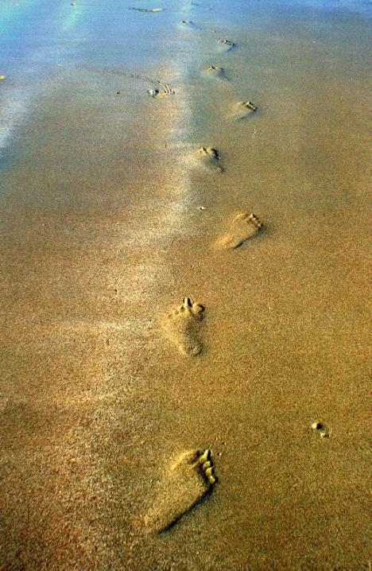
BETTER
EXPERIENCE
Our extremely high standards in day-to-day execution is clock-worked and led by a constantly trained and highly skilled team that is beside you at any given moment to remove all obstacles and absorb inconveniences for you and your guests, to make the trip utterly authentic, enjoyable and carefree.
Last Day before heading back

Slide 9
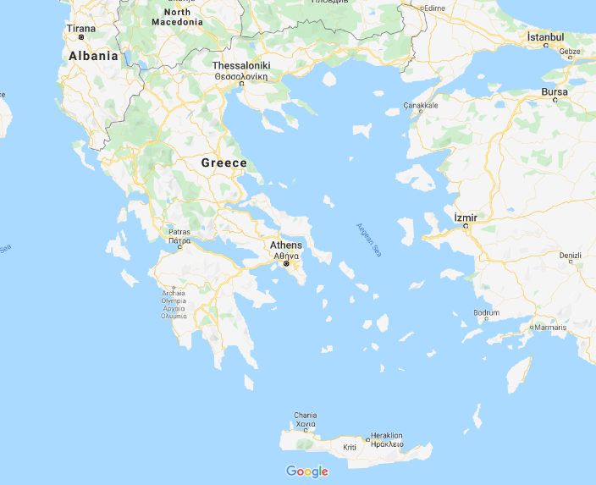
GREECE

Slide 10
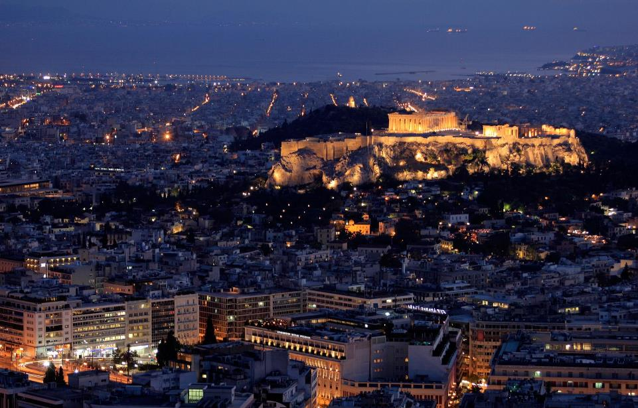
ATHENS
Discover the city where everything started…. The benchmark of the civilization and democracy.

Slide 11
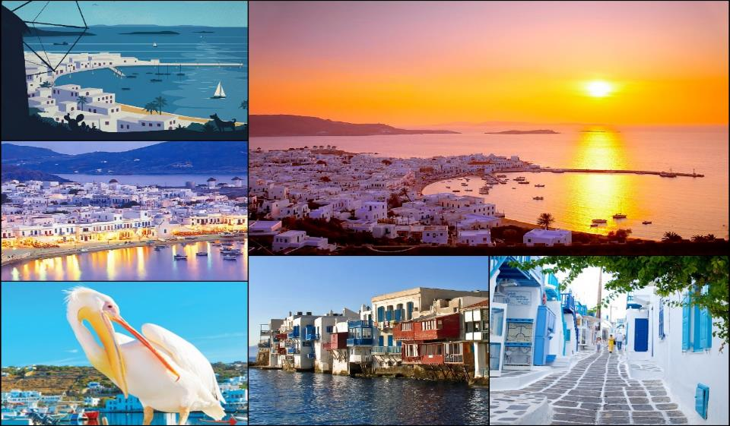
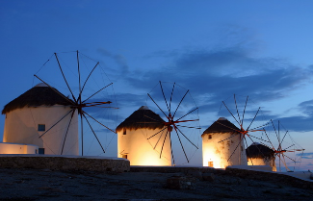
MYKONOS
Enjoy Mykonos the great glamour island of Greece !
Explore, enjoy and relax on the most famous beaches, in the most iconic island in the world !

Slide 12
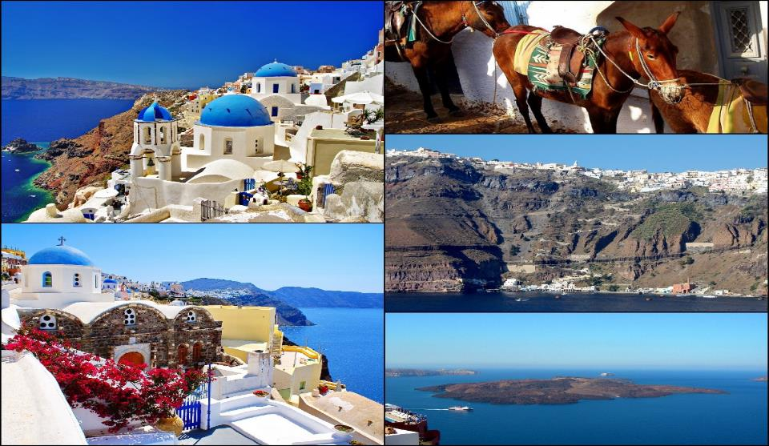
SANTORINI
Santorini. The crescent-shaped island, the precious gem of the Aegean.

Slide 13
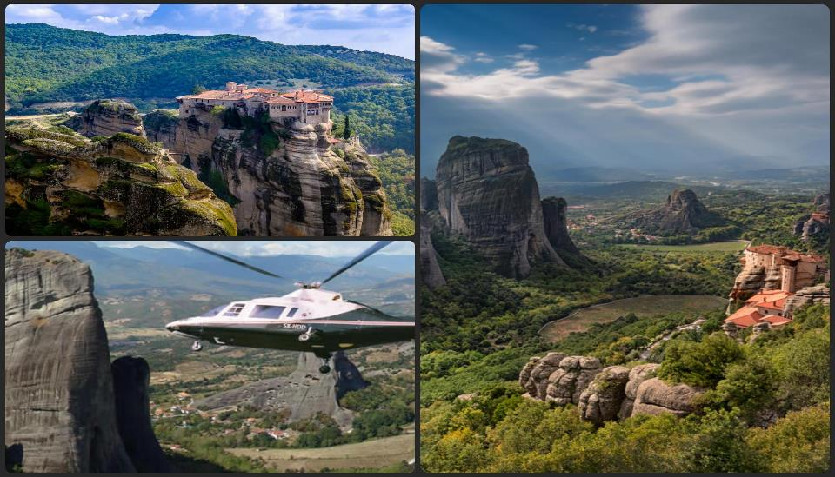
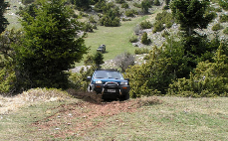
METEORA
From 4X4 to a Helicopter ride A UNESCO WORLD HERITAGE SITE, the monasteries of Meteora one of the most extraordinary sights in mainland Greece can be visited. Built into and on top of huge pinnacles of smooth rock, the earliest monasteries were reached by climbing articulated removable ladders.

Slide 14
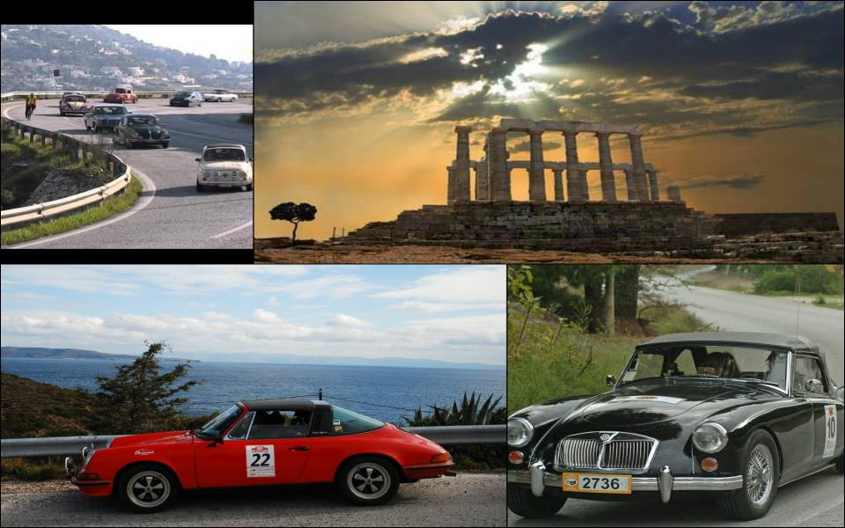
VINTAGE CARS TO SOUNIO
Vintage Car driving along the Athens Riviera coastal road to Poseidon Temple in Sounio. The most magnificent and unique passage from modern to ancient era next to the deep blue clear crystal waters under the endless blue sky.

Slide 15
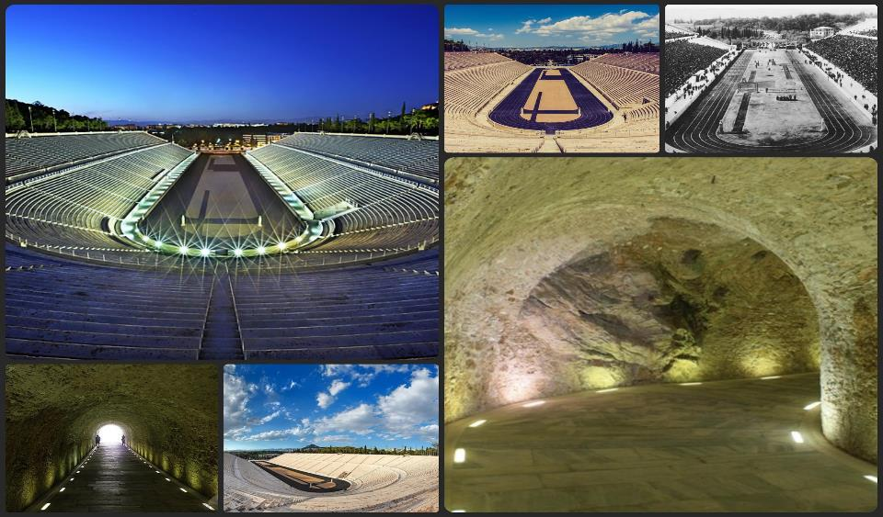
THE OLYMPIC GAMES WORKOUT
Get the background on what the Olympics were really about, in venues connected to real Olympic events. Find out more about how ancient Olympic athletes trained and learn some techniques used by modern athletes before you compete in a race in the world’s first modern Olympic Stadium.

Slide 16
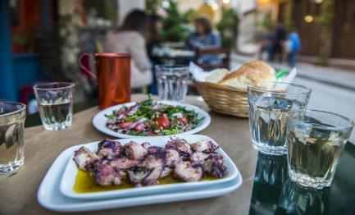
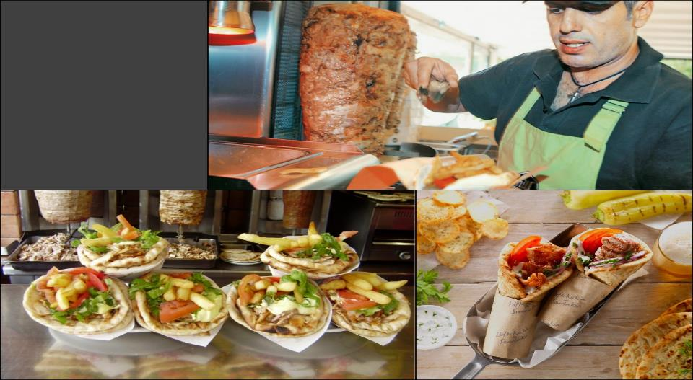
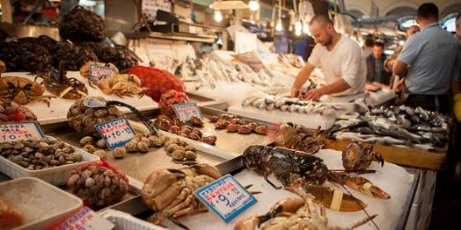
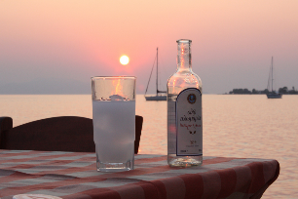
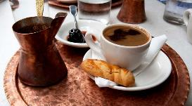
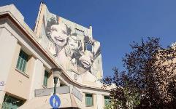
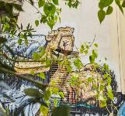
THE CITY STREETS AND GREAT EATS TOUR
Athens came together through a mixture of cultures across the centuries, and there’s still a lot of that history around, in the food as well as in the neighborhoods – this combination tour lets you see and taste your way through the complex heritage that created contemporary Greek culture and cuisine.

Slide 17
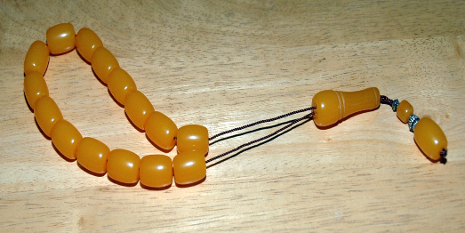
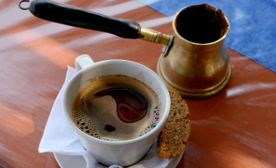
BE AN ATHENIAN FOR A DAY !
Under this unique Farscape concept guests will learn how to make their own Souvlaki, prepare a greek coffee, taste ouzo, make komboloi and greek leather sandals.

Slide 18
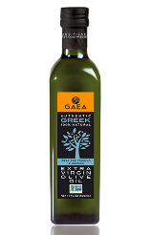
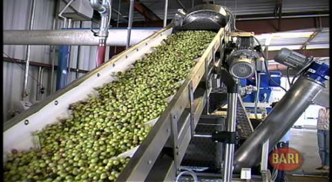
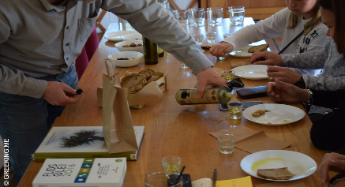
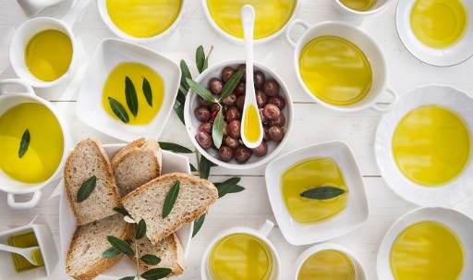
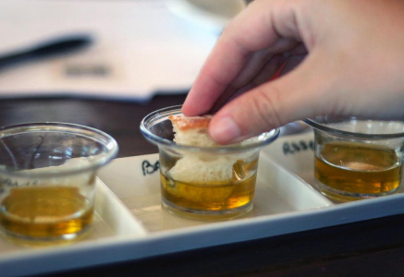
OLIVE OIL FACTORY AND TASTING
Under the concept BE ATHENIAN FOR ONE DAY
guests will learn how to make their own Souvlaki, roll it and eat it!
A casual LUNCH to remember
“They say it may be the best olive oil in the world. We say it is. Taste it but most of all be a part of this old and unique production process in a traditional oil mill”

Slide 19
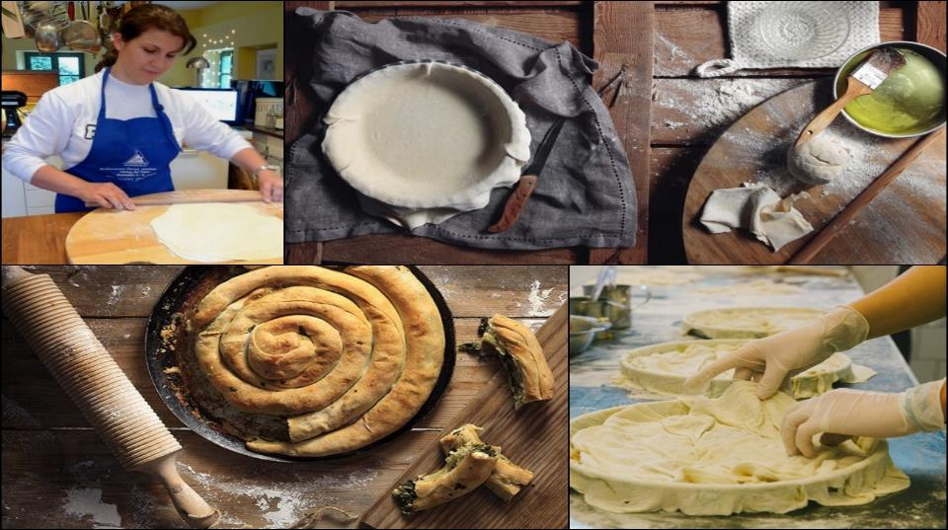
GREEK PITA MAKING
Under the concept BE ATHENIAN FOR ONE DAY
guests will learn how to make their own Souvlaki, roll it and eat it!
A casual LUNCH to remember
One of the most traditional and healthier pie you won’t find elsewhere. Be among the few to get know how to make it.

Slide 20
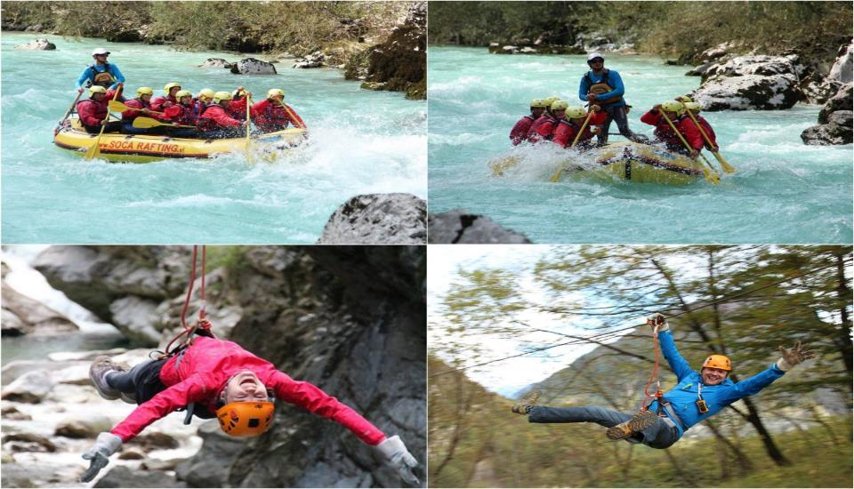
RAFTING - ZIP LINE
Puddle in the clear but sometimes rough waters of one of the most unique rivers with it’s estuary marking the way to the...underworld according to Greek Mythology.

Slide 21
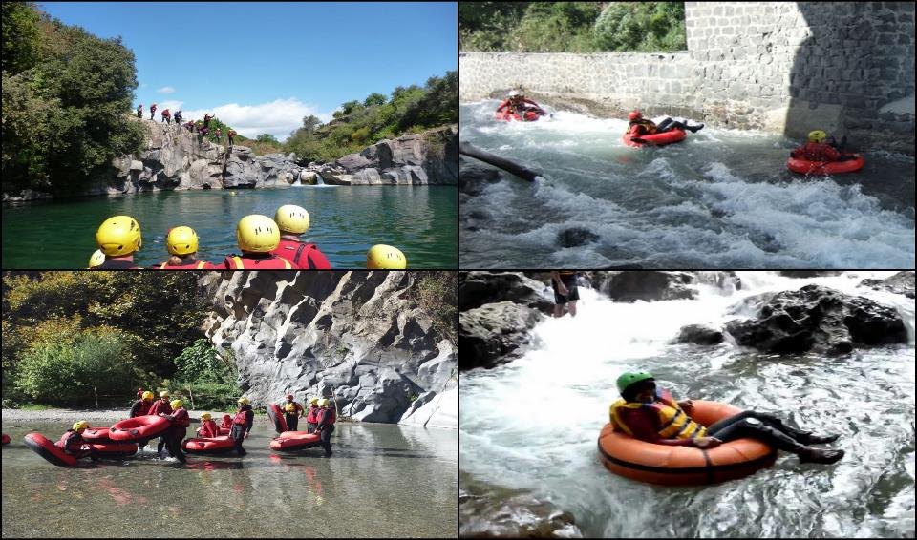
TUBING SLIDE
Before starting the Puddle in the clear but sometimes rough waters of one of the most unique rivers with it’s estuary marking the way to the...underworld according to Greek Mythology.

Slide 22
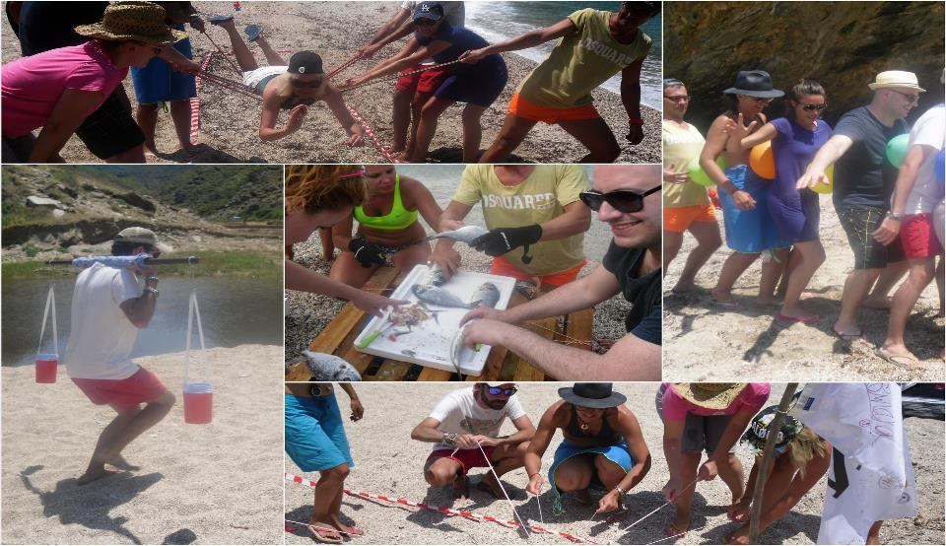
SURVIVOR GAME
Try the Real Survivor quest. Tracking your way to the beach and finding your food for your team it’s not going to be an easy think. You have to try very hard.

Slide 23
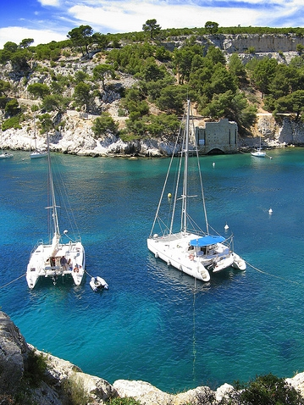
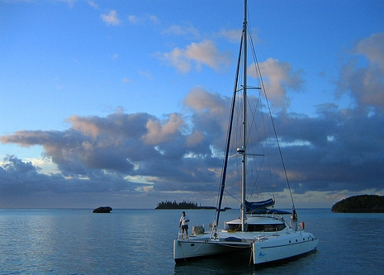
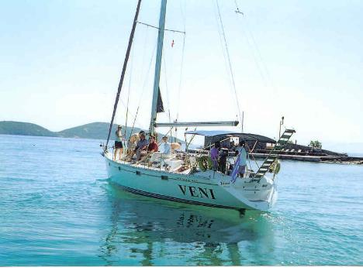
REGATTA
Let the wind blow to help you sail through the clear crystal waters of the Greek Sea. A one of a kind sail rally that will not only increase the levels of adrenaline but will also give you the chance to get to know all the secrets of unique islands of Paros, Naxos & Mykonos.

Slide 24
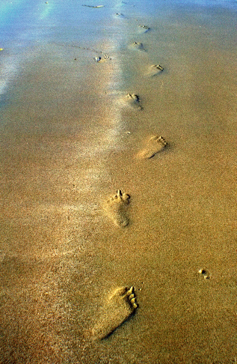
HERE IS HOW you benefit
BETTER
PLANNING
BETTER
VALUE
BETTER
EXPERIENCE

Slide 25
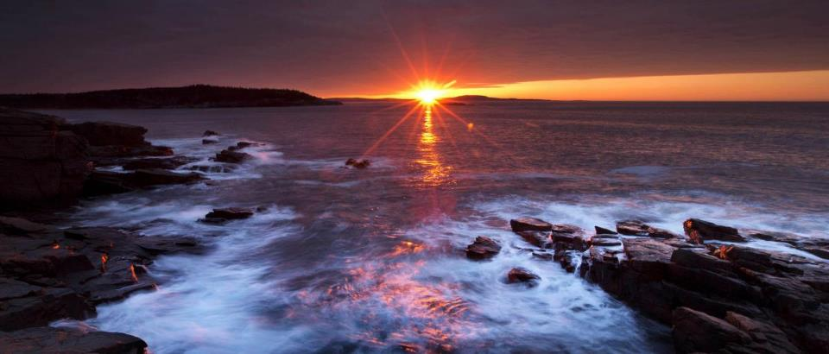
“We listen to our customers, we go far to understand what they need and then we provide it to them.”
BOUTIQUE TRAVEL
Notes:
25

